Slide 1


Computational Intelligence (TC2023)

Slide 2

Unit Goal
Understanding the techniques for classifying network traffic.

Slide 3
Unit IV –Network Traffic Analysis (1)
Outline
Theory of Network Defense
Offensive Security
Capture Data
Feature Engineering
Feature Engineering Technics

Slide 4

Theory of Network Defense

Slide 5

Access Control
Access control is a form of authorization by which you can control which users, roles, or hosts in the organization can access each segment of the network.

Slide 6

Authentication
Authentication is the act of proving an assertion, such as the identity of a computer system user. In contrast with identification, the act of indicating a person or thing's identity, authentication is the process of verifying that identity.

Slide 7
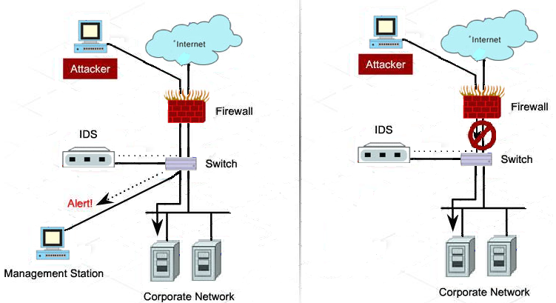
Intrusion Detection System (IDS) x Intrusion Prevention System (IPS)
Provides a Passive Defense
Provides an Active Defense

Slide 8

Honeypots

Slide 9
Offensive Security

Slide 10
Threat Model (Passive Attacks)
Passive attacks do not initiate communication with nodes in the network and do not interact with or modify network data.
Attackers typically use passive techniques for information gathering and reconnaissance activity.
Ex.: an open port 27017 suggests a running MongoDB instance

Slide 11
Threat Model (Active Attacks)
Network Breaches are perhaps the most prolific network attacks.
The term “breach” can refer to either a hole in the internal network’s perimeter or the act of an attacker exploiting such a hole to gain unauthorized access to private systems.
Data breaches by insiders also pose a significant network threat.
Insider threat detection aims to detect when legitimate human actors within a system compromise that system (e.g., a corrupt employee trying to sell business secrets to competitors).

Slide 12
Threat Model (Active Attacks)
Spoofing: Attackers use spoofing (i.e., sending falsified data) as a mechanism for installing their presence in the middle of a trusted communications channel between two entities.
DNS spoofing and ARP spoofing (cache poisoning)

Slide 13
Threat Model (Active Attacks)
Pivoting: is the technique of moving between servers in a network after an attacker has gained access to an entry point.
Many high-profile data breaches have involved attackers pivoting through the network after gaining access to a low-value host.

Slide 14
Threat Model (Active Attacks)
Denial-of-service (DoS) attacks target the general availability of a system, disrupting access to it by intended users.
There are many flavors of DoS attacks, include ing the distributed DoS (DDoS) attack, which refers to the use of multiple IP addresses that might span a large range of geolocations to attack a service.
SYN flooding is a method of DoS that misuses the TCP handshake mechanism and exploits carelessly implemented endpoints.

Slide 15
Threat Model (Active Attacks)
A botnet is a network of compromised privately owned computers that are infected (without the owners’ knowledge) with malicious software and used for remote access.
Zombies that are part of a network might not be considered active network attackers but can have equally damaging consequences when the botnet is activated.

Slide 16
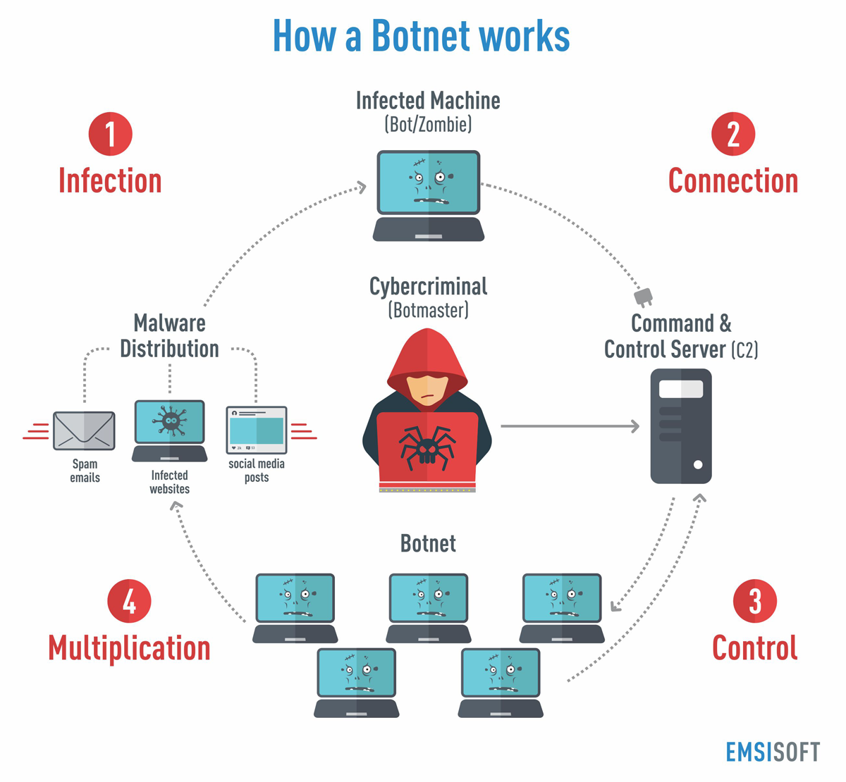
Threat Model (Active Attacks)

Slide 17
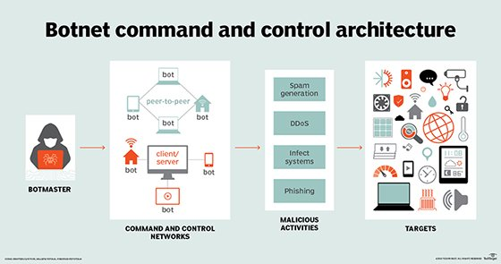
Threat Model (Active Attacks)

Slide 18
Capture Data

Slide 19
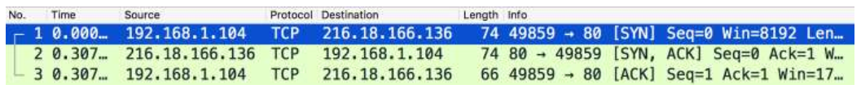
Machine Learning and Network Security
Pattern mining is one of the primary strengths of machine learning, and there are many inherent patterns to be discovered in network traffic data.
At first glance, the data in network packet captures might seem sporadic and random, but most communication streams follow a strict network protocol.
TCP three-Way handshake

Slide 20
Machine Learning and Network Security
Pattern mining is one of the primary strengths of machine learning, and there are many inherent patterns to be discovered in network traffic data.
At first glance, the data in network packet captures might seem sporadic and random, but most communication streams follow a strict network protocol.
TCP three-Way handshake

Slide 21
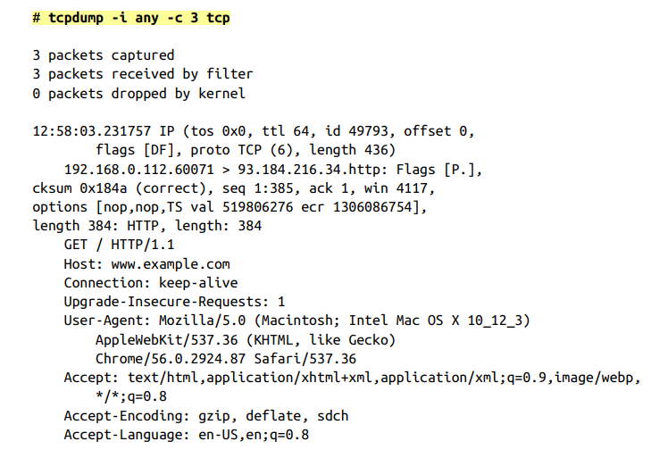
Capture Data
Tcpdump is a command-line packet analyzer that is ubiquitous in modern Unix-like operating systems.
Captures are made in the libpcap file format (.pcap).

Slide 22
Capture Data
Aggregating patterns across large sequences of packets can allow you to generate more useful information from the data than analyzing single packets.
For instance, trying to detect SQL injections over the network by doing analysis on the packet level will cause you to look at a lot of useless packets due to protocol communication overhead.
On the other hand, trying to detect Internet Control Message Protocol (ICMP) flooding DoS attacks requires analysis on the packet level because there are no sessions to speak of.

Slide 23
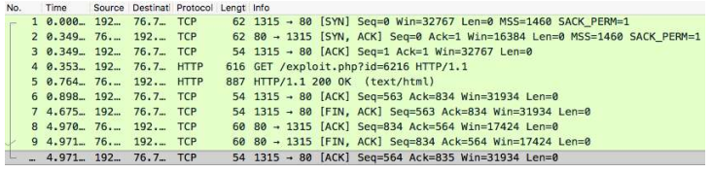
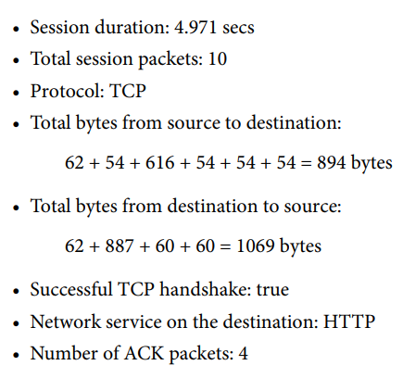
Attacker TCP Session

Slide 24
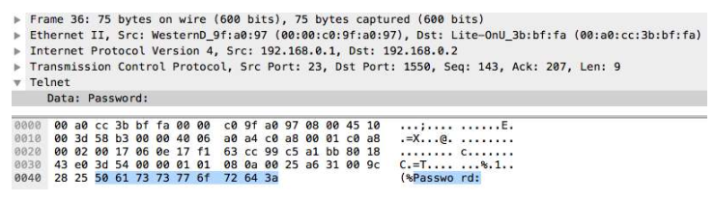
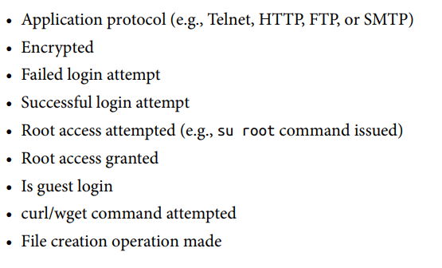
Analyze of Authentication Sessions

Slide 25
Feature Engineering

Slide 26
What is Feature Engineering?
Feature extraction and engineering is the process of interpreting raw data to generate facets of the data that best represent its nature.
The goal of feature engineering is simply to make your data better suited to the problem at hand.
You might perform feature engineering to:
improve a model's predictive performance
reduce computational or data needs
improve interpretability of the results

Slide 27
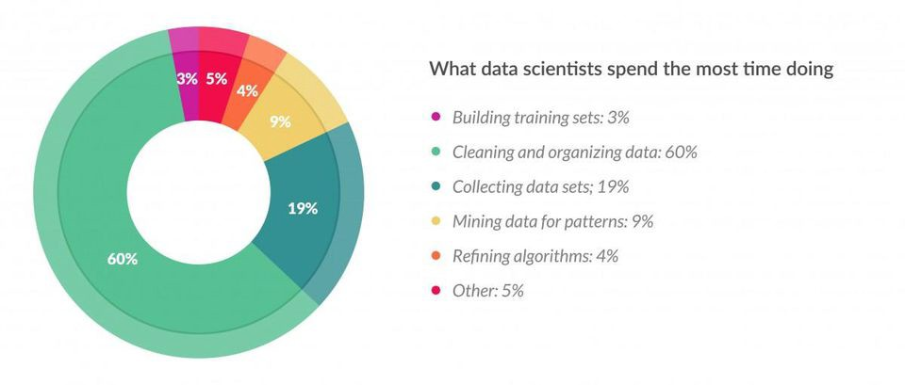
What is Feature Engineering?

Slide 28
Feature Engineering Questions
Importance of domain knowledge: deep domain expertise in the application area can help to very quickly identify important features to collect to help learning algorithms.
Intuitive understanding of computer networking, OS fundamentals, code execution processes, and so on before you begin to apply machine learning to these areas.

Slide 29
Feature Engineering Questions
Scalable data collection processes: To get good results, we often need to feed large amounts of data into our machine learning algorithms.
It is crucial to think about the automation of data collection processes before you have to scale up your operation.

Slide 30
Feature Engineering Questions
Validation and bias: How do you know that the collected data is correct and complete?
Data validation is of paramount importance, because systematic and consistent errors in data collection can render any downstream analysis invalid and can have catastrophic results on a machine learning system.
Dealing with intrinsic bias in the collected data requires a little bit more nuance, because it is more difficult to detect even upon manual inspection. The only way to reliably detect such an issue is to explicitly consider it as a potential cause for poor machine learning results.

Slide 31
Feature Engineering Questions
Iterative Experimentation: Machine learning is a process of iterative experimentation, and the data collection phase is no exception. If you get stuck with bad results at a certain point in the process, remember to approach the situation with a scientific mindset and treat it as a failed instance of a controlled experiment.

Slide 32
Feature Engineering Technics

Slide 33
Overfitting x Underfitting
Underfitting: can be seen when our model is too simple to explain the variation presented by the data.
Overfitting: the production of an analysis that corresponds too closely or exactly to a particular set of data and may therefore fail to fit additional data or predict future observations reliably.

Slide 34
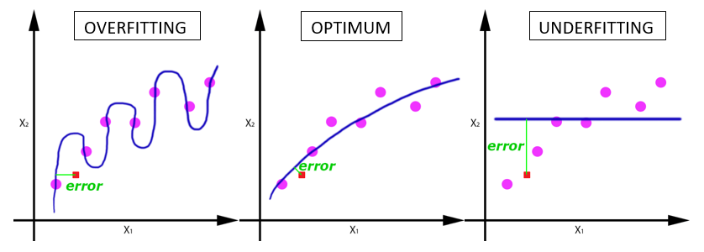
Overfitting x Underfitting

Slide 35
Imputation
Missing values are one of the most common problems you can encounter when you try to prepare your data for machine learning.
The reason for the missing values might be human errors, interruptions in the data flow, privacy concerns, and so on.

Slide 36
Numeric Imputation
#Filling all missing values with 0 data = data.fillna(0)
#Filling missing values with medians of the columns data = data.fillna(data.median())
Categorical Imputation
#Max fill function for categorical columns data['column_name'].fillna(data['column_name'].value_counts() .idxmax(), inplace=True)

Slide 37
Handling Outliers
Outlier Detection with Standard Deviation
If a value has a distance to the average higher than x * standard deviation, it can be assumed as an outlier. Then what x should be?
There is no trivial solution for x, but usually, a value between 2 and 4 seems practical.
#Dropping the outlier rows with standard deviation factor = 3 upper_lim = data['column'].mean () + data['column'].std () * factor lower_lim = data['column'].mean () - data['column'].std () * factor data = data[(data['column'] < upper_lim) & (data['column'] > lower_lim)]

Slide 38
Outlier Detection with Percentiles
You can assume a certain percent of the value from the top or the bottom as an outlier.
Additionally, a common mistake is using the percentiles according to the range of the data. In other words, if your data ranges from 0 to 100, your top 5% is not the values between 96 and 100. Top 5% means here the values that are out of the 95th percentile of data.
#Dropping the outlier rows with Percentiles upper_lim = data['column'].quantile(.95) lower_lim = data['column'].quantile(.05) data = data[(data['column'] < upper_lim) & (data['column'] > lower_lim)]

Slide 39
An Outlier Dilemma: Drop or Cap
Another option for handling outliers is to cap them instead of dropping.
So, you can keep your data size and at the end of the day, it might be better for the final model performance.
#Capping the outlier rows with Percentiles upper_lim = data['column'].quantile(.95) lower_lim = data['column'].quantile(.05)
data.loc[(df[column] > upper_lim),column] = upper_lim data.loc[(df[column] < lower_lim),column] = lower_lim

Slide 40
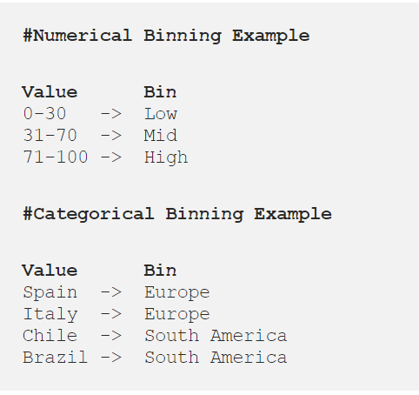
Binning
Binning can be applied on both categorical and numerical data.
The main motivation of binning is to make the model more robust and prevent overfitting, however, it has a cost to the performance.
Every time you bin something, you sacrifice information and make your data more regularized.

Slide 41
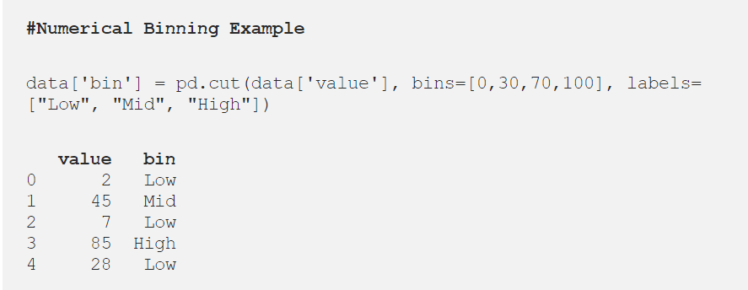
Binning
The trade-off between performance and overfitting is the key point of the binning process.

Slide 42
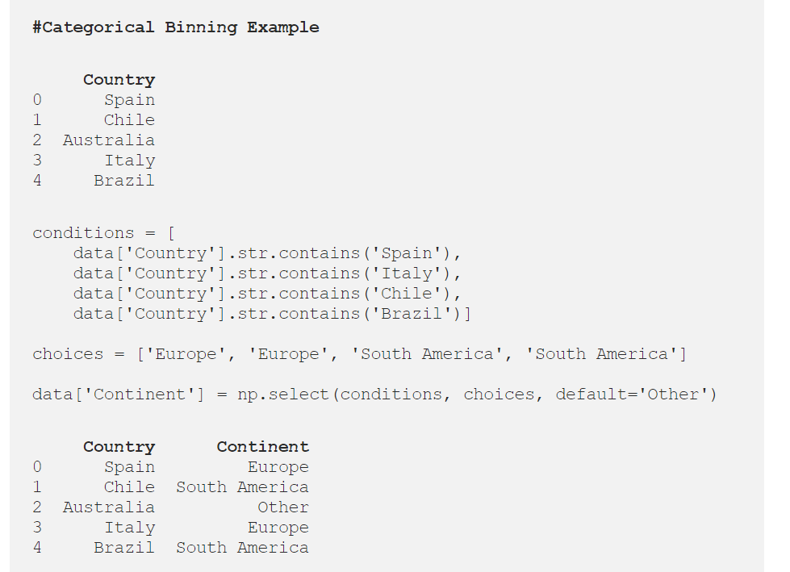
Binning

Slide 43
Log Transformation
Logarithm transformation (or log transform) is one of the most used mathematical transformations in feature engineering.
It helps to handle skewed data and after transformation, the distribution becomes more approximate to normal.
In most of the cases the magnitude order of the data changes within the range of the data.
It also decreases the effect of the outliers, due to the normalization of magnitude differences and the model become more robust.

Slide 44
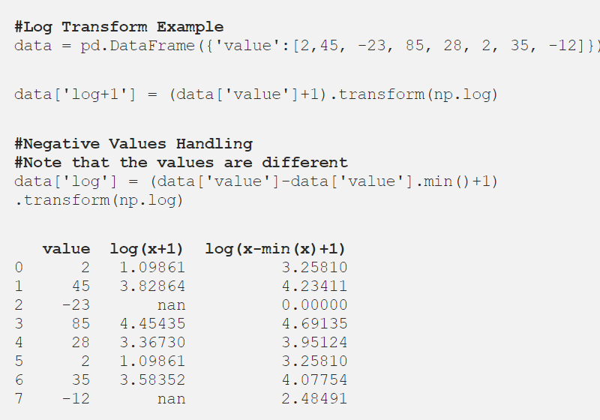

Slide 45
One-hot encoding
One-hot encoding is one of the most common encoding methods in machine learning.
This method spreads the values in a column to multiple flag columns and assigns 0 or 1 to them. These binary values express the relationship between grouped and encoded column.
This method changes your categorical data, which is challenging to understand for algorithms, to a numerical format and enables you to group your categorical data without losing any information.

Slide 46
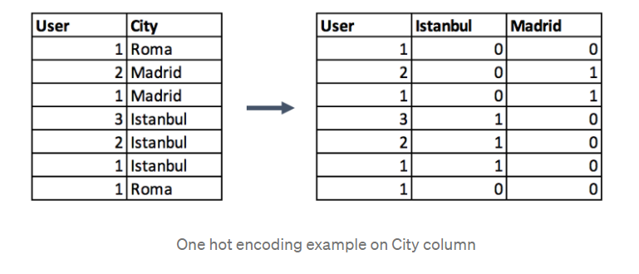
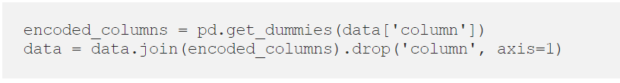

Slide 47
Feature Splitting
Most of the time the dataset contains string columns that violates tidy data principles.
By extracting the utilizable parts of a column into new features:
We enable machine learning algorithms to comprehend them.
Make possible to bin and group them.
Improve model performance by uncovering potential information.

Slide 48
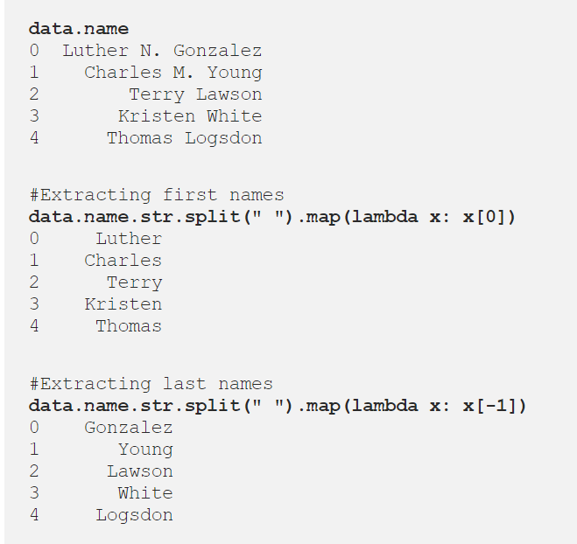
Feature Splitting

Slide 49
Scaling
In most cases, the numerical features of the dataset do not have a certain range and they differ from each other.
In real life, it is nonsense to expect age and income columns to have the same range. But from the machine learning point of view, how these two columns can be compared?
Scaling solves this problem. The continuous features become identical in terms of the range, after a scaling process.

Slide 50
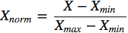
Scaling
Normalization (or min-max normalization): scale all values in a fixed range between 0 and 1. This transformation does not change the distribution of the feature and due to the decreased standard deviations, the effects of the outliers increases.

Slide 51
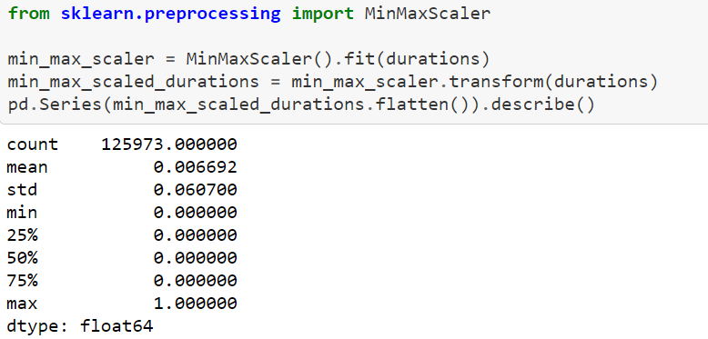
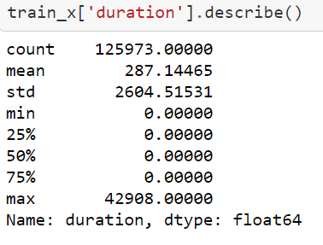
Normalization

Slide 52
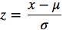
Scaling
Standardization (or z-score normalization): scales the values while taking into account standard deviation. If the standard deviation of features is different, their range also would differ from each other. This reduces the effect of the outliers in the features.
the mean is shown as μ and the standard deviation is shown as σ.

Slide 53
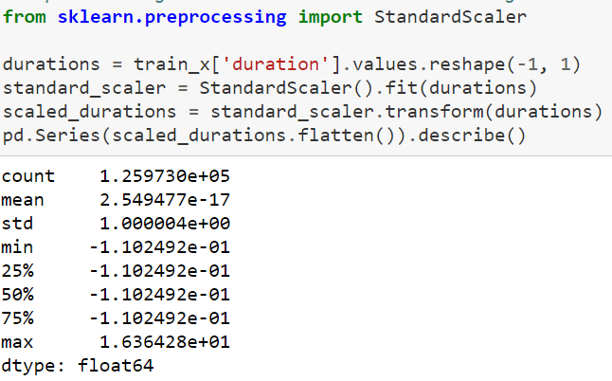
Standardization

Slide 54
Unit IV –Network Traffic Analysis (1)
Outline
Theory of Network Defense
Offensive Security
Capture Data
Feature Engineering
Feature Engineering Technics

Slide 55
Computational Intelligence (TC2023)

